Slide 1
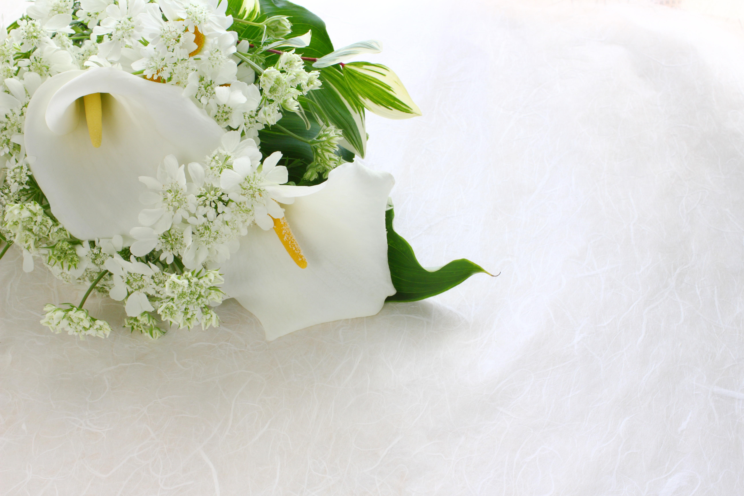

Celebrations of Life at Hazlemere Golf Club

Slide 2


Thank you for your enquiry into having a
Funeral, Wake or Celebration of Life
at Hazlemere Golf Club
We have two function rooms available to hire
The Pines Suite which can hold up to 60 guests
A Room Hire of £125 + VAT for 4 Hours
The Fairways Suite which can hold up to 180 guests
A Room Hire of £225 + VAT for 4 Hours
The Pines Suite is located on the ground floor which
has its own patio area, cloakroom facilities including
disabled and baby changing area, there is also an
in built Screen & Projector
The Fairways Suite is located on the 1st floor (we do have a lift)
with its own exclusive bar area, large balcony overlooking the
golf course, cloakroom facilities including disabled toilets
PLEASE NOTE IF WISHING TO BRING EXTERNAL CATERING
THERE WILL BE AN ADDITIONAL VENUE HIRE
If you require further information please do contact
emily@hazlemeregolfclub.co.uk – 01494 719300

Slide 3
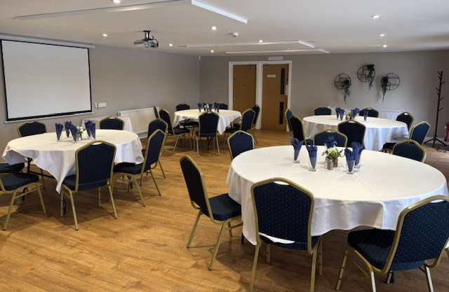
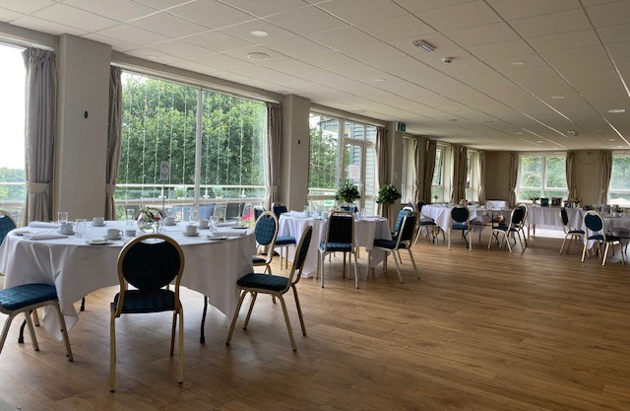
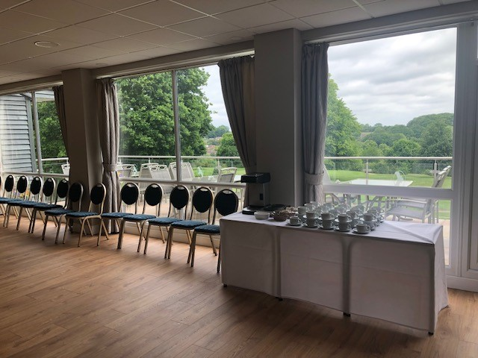
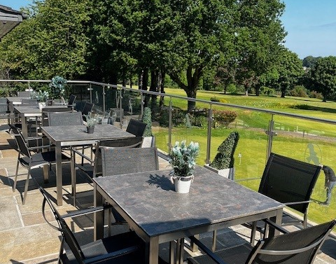
The Pines Suite
The Fairways Suite

Slide 4
Funeral Buffet A
A Slice of Homemade Cake
including Victoria Sandwich, Lemon Drizzle
Chocolate, Bakewell and many more
(D)(G)(E)
Tea or Coffee (1 cup per person )
At £5.50 per person
Allergens
(G) Gluten (D) Dairy (Sul) Sulphite
(E) Eggs (B) Barley (SO) Soya (M) Mustard (F) Fish
(Crus ) Crustacean
Hazlemere Golf Club
Penn Road, Hazlemere, Buckinghamshire, HP15 7LR
Tel – 01494 719300 or email Emily@hazlemeregolfclub.co.uk

Slide 5

Funeral Buffet B
A selection of sandwiches on white & brown bread
Egg Mayonnaise (m)(e)
Cheese & Pickle (d)
Ham & Mustard (m)
Tuna Mayonnaise (f)(m)(e)
Bowls of Tyrell crisps
A Slice of Homemade Cake
LEMON DRIZZLE * VICTORIA SANDWICHES * CHOCOLATE
(d)(g)(e)
At £10.50 per person
Allergens
(G) Gluten (D) Dairy (Sul) Sulphite
(E) Eggs (B) Barley (SO) Soya (M) Mustard (F) Fish
(Crus ) Crustacean
Hazlemere Golf Club
Penn Road, Hazlemere, Buckinghamshire, HP15 7LR
Tel – 01494 719300 or email Emily@hazlemeregolfclub.co.uk
Tea & Coffee Station
Available at £2.00 per cup

Slide 6

Funeral Buffet C
A selection of sandwiches on white & brown bread
Egg Mayonnaise (m)(e)
Cheese & Pickle (d)
Ham & Mustard (m)
Tuna Mayonnaise (f)(m)(e)
Hummus & Peppers (sesame seeds)
Bowls of Chips
Sausage Rolls (w)(e)(milk)
Dessert Platter to include
Homemade cakes, millionaire shortbreads, macaroons, profiteroles, fresh fruits
(g)(d)(e)(m)(wheat)
At £16.50 per person
Allergens
(G) Gluten (D) Dairy (Sul) Sulphite
(E) Eggs (B) Barley (SO) Soya (M) Mustard (F) Fish
(Crus ) Crustacean
Hazlemere Golf Club
Penn Road, Hazlemere, Buckinghamshire, HP15 7LR
Tel – 01494 719300 or email Emily@hazlemeregolfclub.co.uk
Tea & Coffee Station
Available at £2.00 per cup

Slide 7
Funeral Buffet D
A selection of sandwiches on white & brown bread
Egg Mayonnaise (m)(e)
Cheese & Pickle (d)
Ham & Mustard (m)
Tuna Mayonnaise (f)(m)(e)
Hummus & Peppers (sesame seeds)
HOT ITEMS
Chicken Bites (w)
Sausage Rolls (w)(e)(milk)
Cod Goujons with tartar sauce (w)(e)(f)
Duck Spring Rolls with a chilli dip (w)(barley)(sesame)(so)(sul)
Selection of Mini Vegetarian Quiches (w)(e)(m)
Vegetarian Bites
Bowls of Chips
Dessert Platter to include
Homemade cakes, millionaire shortbreads, macaroons, profiteroles, fresh fruits
(g)(d)(e)(m)(wheat)
At £22.00 per person
Allergens
(G) Gluten (D) Dairy (Sul) Sulphite
(E) Eggs (B) Barley (SO) Soya (M) Mustard (F) Fish
(Crus ) Crustacean
Hazlemere Golf Club
Penn Road, Hazlemere, Buckinghamshire, HP15 7LR
Tel – 01494 719300 or email Emily@hazlemeregolfclub.co.uk
Tea & Coffee Station
Available at £2.00 per cup

Slide 8

Funeral Buffet E
A selection of sandwiches on white & brown bread
Egg Mayonnaise (m)(e)
Chicken & Avocado with Mayonnaise (m)
Prawn Mayonnaise (crus)(m)(e)
Cream Cheese & Cucumber (D)
Roast Beef & Mustard (M)
HOT ITEMS
Sausage Rolls (w)(e)(milk)
Mini Pork Pies (D)
Vol au vents with selection of
creamy mushroom, brie & cranberry, cream cheese & salmon topping (w)(d)(f)(m)
Homemade Quiches – salmon & broccoli – Quiche Lorraine (d)(e)(crus)(f)
Breaded mini Camembert rounds (d)(w)
Crispy Tempura Vegetable Bites (m)
Bowls of Chips
Dessert Platter to include
Homemade cakes, millionaire shortbreads, macaroons, profiteroles, fresh fruits
(g)(d)(e)(m)(wheat)
At £28.00 per person
Allergens
(G) Gluten (D) Dairy (Sul) Sulphite
(E) Eggs (B) Barley (SO) Soya (M) Mustard (F) Fish
(Crus ) Crustacean
Hazlemere Golf Club
Penn Road, Hazlemere, Buckinghamshire, HP15 7LR
Tel – 01494 719300 or email Emily@hazlemeregolfclub.co.uk
Tea & Coffee Station
Available at £2.00 per cup

Slide 9

HAZLEMERE GOLF CLUB WINE LIST | Price List as of JANUARY 2026 please note prices may increase due to inflationary rate rises
White Wines
Previata Pinot Grigo Delle Venezie, Italy 12% Crisp and fruity with crunchy fruit, citrusy acidity and a long refreshing finish | £24.00 per bottle
Mud House Sauvignon Blanc, Chile 12.5% Zesty white wine rich in a fruit intensity and vitality with generous flavour complexity and refreshing crispness | £28.00 per bottle
Rose Wines
Previta Pinot Grigio Blush, Italy 12% Fruity and refreshing with flavours of apricot, peach & strawberries | £25.00 per bottle
Calvet Rose, France 11% Pleasant on the palate with a ripe summer berry fruit compote | £22.00 per bottle
Red Wines
San Andres Valle Central Merlot, Chile 12.5% Fruit flavours of ripe, cherry and plum and a delicate hint of spice | £26.00 per bottle
Trivento Reserve Malbec, Argentina 13.5% Plum and raspberry aromas with vanilla notes | £29.50 per bottle
Sparkling Wines & Champagne
Prosecco Vino Spumante, Italy 10.5% Lemon fruit notes & a refreshing lively style | £27.00 per bottle
Taittinger Champagne Brut Reserve, Reims 12.5% | £70.00 per bottle

Slide 10

Hazlemere Golf Club | Terms & Conditions
No person under the age of 18 will be accepted to hire either the Pines Suite or the Fairways Suite | Hazlemere Golf Club reserve the right to request the attendance of accredited security staff for any function – to cost of this will be chargeable to the hirer,
Food & Drink must be supplied by Hazlemere Golf Club including soft drinks | Cancellation charges are as follows
The hirer will be liable for any damage to the building, furnishing and golf course resulting from their guest’s actions | Please note these charges are over and above the deposit 7 days notice 50% of full payment
The Golf Course and putting green are strictly for the use of playing golfers
Children attending any function must be supervised by an adult at all times
Deposits are non refundable
All prices are subject to change without prior notification

