Slide 1

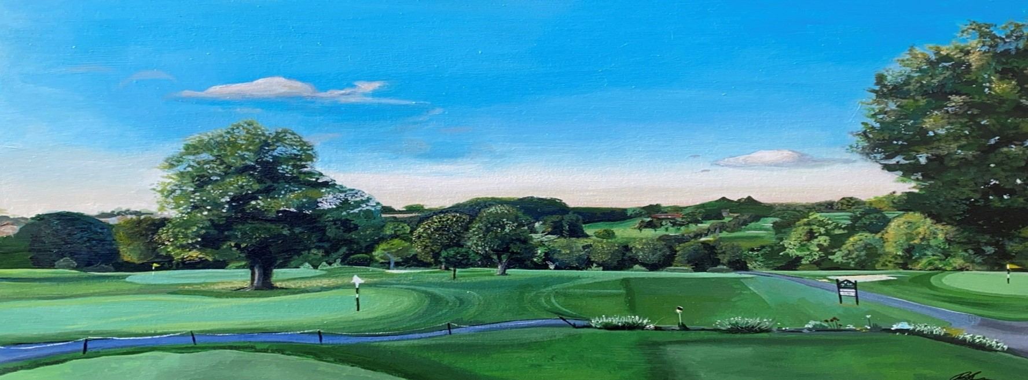
WEDDINGS & CELEBRATIONS
Hazlemere Golf Club – Penn Road – Hazlemere – Buckinghamshire - HP15 73R
emily@hazlemeregolfclub.co.uk – Tel 01494 719300

Slide 2


Slide 3
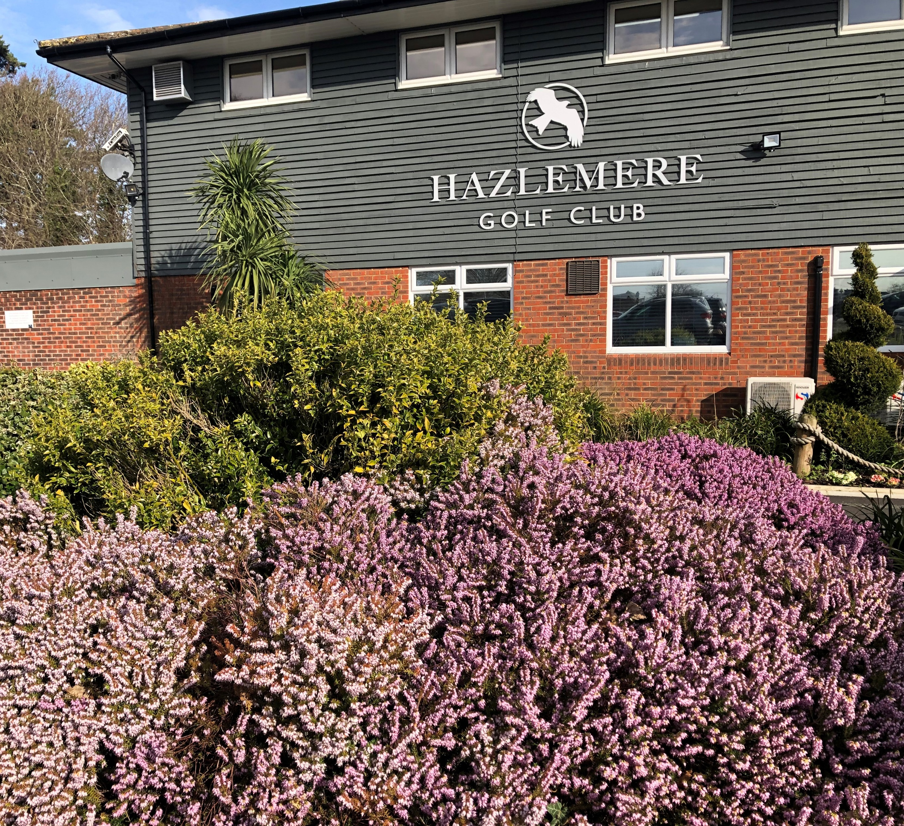
MANY CONGRATULATIONS !
Thank you for your enquiry regarding your forthcoming Wedding Reception / Ceremony / Party. We are delighted that you are considering Hazlemere Golf Club as your chosen venue.
Hazlemere Golf Club located in the village of Hazlemere Buckinghamshire
is licensed to hold civil wedding ceremonies & civil partnerships enabling you to hold your entire Wedding Day in one place.
Whether you are looking for a small and intimate wedding or a much larger celebration, we are confident we can provide you with a magical day to treasure.
The Fairways Suite on the first floor of the Clubhouse has a large balcony overlooking the golf course and benefits from numerous windows ensuring that it is filled with natural daylight. The spacious suite is exclusively yours, with its own private bar area, cloakrooms and lift access, we also have ample car parking for your guests.
Tables are laid with ivory linen to offset any flowers, balloons and table decorations that you may wish to organise. At the front of the Clubhouse we have a large patio area, an ideal location to enjoy your reception drinks and canapes, only a few steps away is our beautiful purpose built decking for those treasured wedding photographs.
Please take a look through the enclosed information, our menus are purposely designed by our Head Chef .
If you have a specific date in mind, please do get in contact to make a provisional booking.
I look forward to hearing from you and hope I can be of assistance in arranging your Wedding Day
Emily Glover – Events, Sales & Marketing Manager – Hazlemere Golf Club

Slide 4
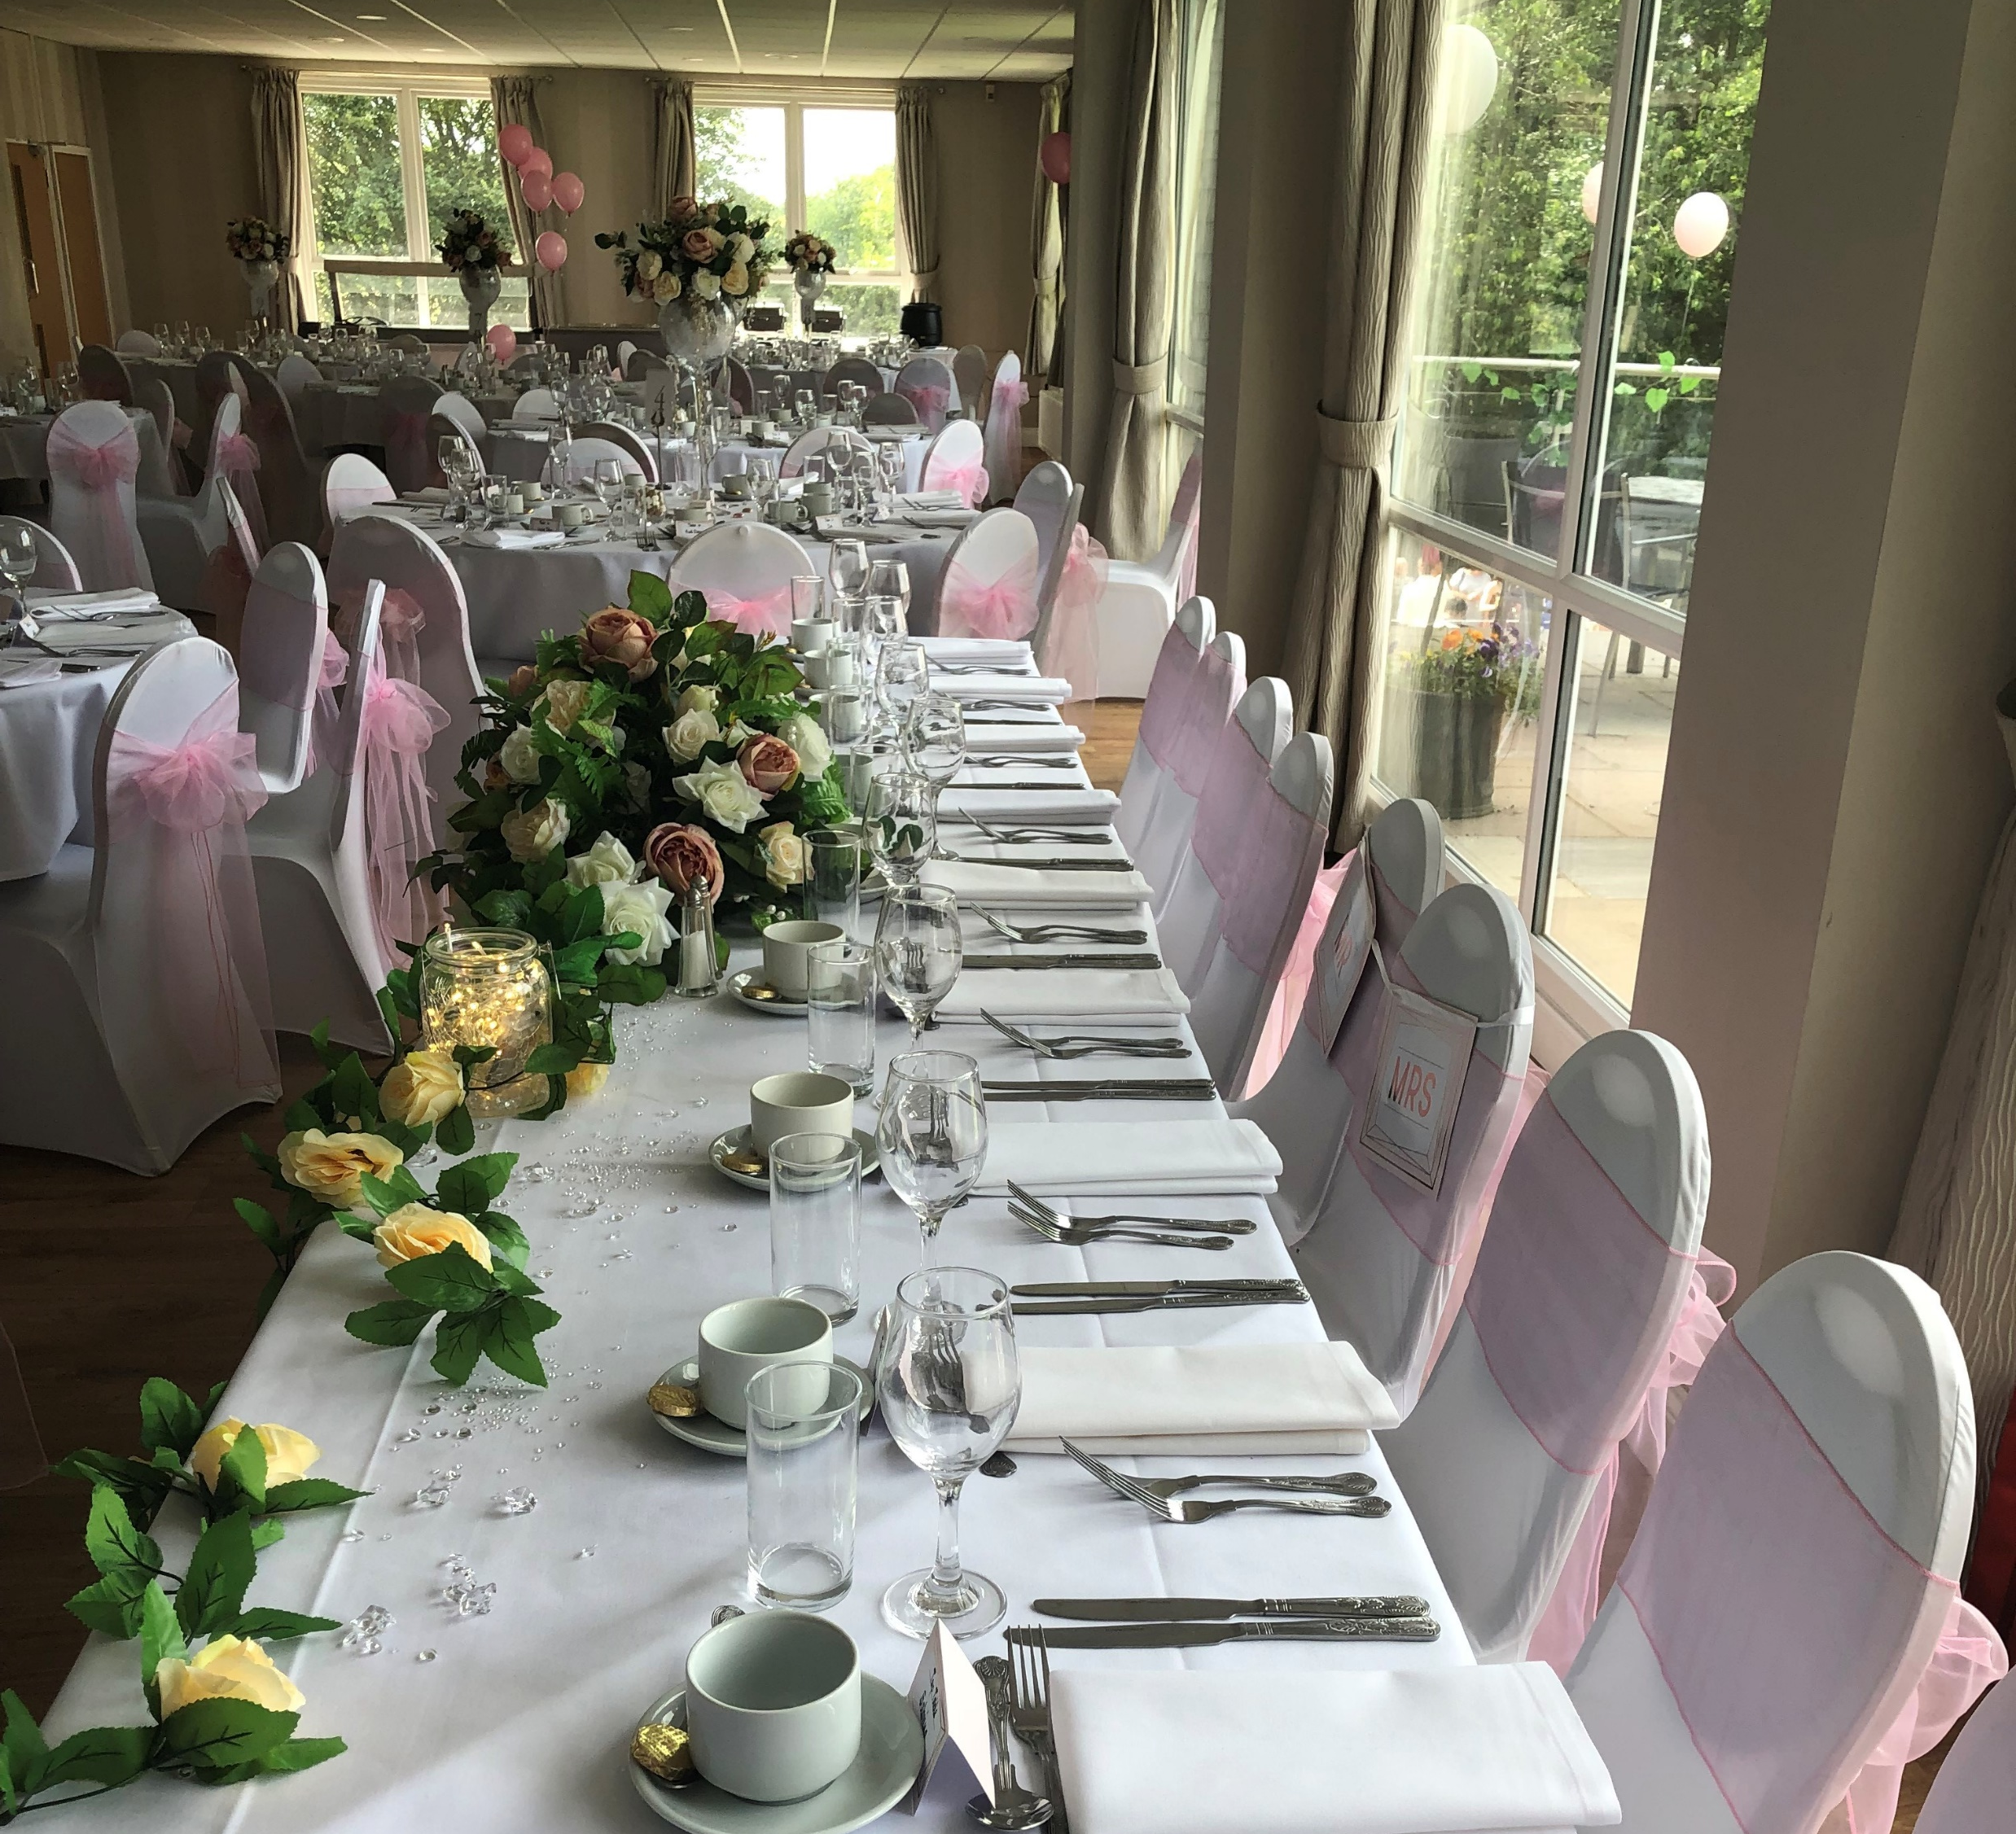
The Fairways Suite
CAPACITY
SIT DOWN WEDDING BREAKFAST – 160 Guests
WEDDING CEREMONY – 160 GUESTS
EVENING RECEPTION – 160 GUESTS
HIRE FEES
Wedding Ceremony Hire £300
Clients will need to book their ceremony directly with Beaconsfield Registry Office
Hourly Room Hire fee of
£160.00 + VAT PER HOUR min of 6 hours hire
CORKAGE
Please note
We do not allow guests to provide alcoholic beverages or soft drinks, all drinks must be purchased from
Hazlemere Golf Club
SET UP CHARGES
£80 + VAT PER HOUR
Ivory linen tablecloths & napkins included
Free secure parking for up to 180 cars

Slide 5

Hazlemere Golf Club
Drink Packages

Slide 6
Drinks Packages
Package A Reception Drinks Prosecco & Fresh Orange Juice Wedding Breakfast Drinks Half a Bottle of House Wine per guest Toast Drink Prosecco for the Toast £26.00 per person | Package B Reception Drinks Prosecco & Fresh Orange Juice 2 Bottles of either Corona, Estrella Budweiser, Birra Moretti Cider Wedding Breakfast Drinks Half a Bottle of Wine per guest Toast Drink Prosecco for the Toast £39.00 per person | Package C Reception Drinks Pimms & Lemonade served with Fresh Fruit & Mint Prosecco & Fresh Orange Juice Wedding Breakfast Drinks Half a Bottle of Wine per guest Toast Drink £37.00 per person With Prosecco Toast £43.00 per person with Champagne Toast
White Wines | Rose Wines | Red Wines
Previata Pinot Grigio Delle Venezie , Italy (House) Mud House Sauvignon Blanc, Chile | Calvet Rose (House) Previata Pinot Grigio Blush | San Andres Valle Central Merlot (House) Trivento Reserve Malbec
Sparkling - Prosecco Vino Spumante & Taittinger Champagne Brut Reserve, Reims

Slide 7

HAZLEMERE GOLF CLUB WINE LIST | Price List as of JANUARY 2026 please note prices may increase due to inflationary rate rises
White Wines
Previata Pinot Grigo Delle Venezie, Italy 12% Crisp and fruity with crunchy fruit, citrusy acidity and a long refreshing finish | £24.00 per bottle
Mud House Sauvignon Blanc, Chile 12.5% Zesty white wine rich in a fruit intensity and vitality with generous flavour complexity and refreshing crispness | £28.00 per bottle
Rose Wines
Previta Pinot Grigio Blush, Italy 12% Fruity and refreshing with flavours of apricot, peach & strawberries | £25.00 per bottle
Calvet Rose, France 11% Pleasant on the palate with a ripe summer berry fruit compote | £22.00 per bottle
Red Wines
San Andres Valle Central Merlot, Chile 12.5% Fruit flavours of ripe, cherry and plum and a delicate hint of spice | £26.00 per bottle
Trivento Reserve Malbec, Argentina 13.5% Plum and raspberry aromas with vanilla notes | £29.50 per bottle
Sparkling Wines & Champagne
Prosecco Vino Spumante, Italy 10.5% Lemon fruit notes & a refreshing lively style | £27.00 per bottle
Taittinger Champagne Brut Reserve, Reims 12.5% | £70.00 per bottle

Slide 8
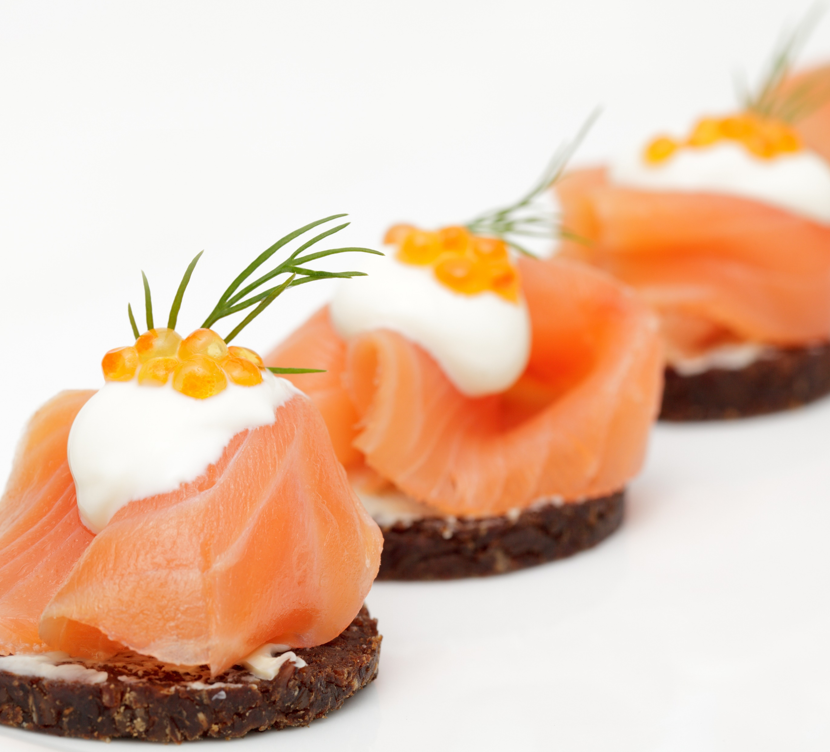
CANAPÉS

Slide 9

Canapé Menu
Prawn Cocktail Baby Cos Cups
Smoked Salmon & Cream Cheese Parcels
Mackerel Pate on Sourdough Bites
Bruschetta French Toast Bites (v)
Chorizo Arancini
Individual Cheddar & Bacon Quiche
Cream Cheese & Chive Bellini (v)
Naan, Spinach & Halloumi Bites (v)
Crostini with peaches, blue cheese & honey (v)
Chicken Fajita Taco Cups
Mini Beef Wellingtons
Tempura Prawns, Teriyaki Dip
Cheese Boards & Charcuterie Boards at £18.00 per board (10 pax)
Canapés individually priced at £2.00 per bite

Slide 10

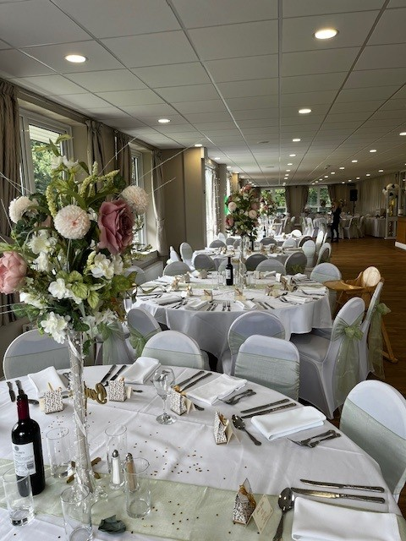
Wedding Breakfast
Create your own delicious Wedding Menu
Set Menu
All your guests having the same starter, main course & dessert
At £40.00 per person
Choice Menu
All your guests choosing from 2 starters, 2 mains and 2 desserts
At £44.00 per person
We do cater for vegetarians and guests with specific dietary requirements if known in advance of your big day.
A full table plan with your guests menu choices will need to be supplied 2 weeks prior.

Slide 11

Wedding Breakfast Starters
Soups
Tomato & Red Pepper Roasted Soup & a Crusty Roll (v) (vegan) (Gluten with roll)
Leek & Potato Soup & a Crusty Roll (v)(vegan) (Gluten with roll)
Pea & Ham Hock Soup & a Crusty Roll (Gluten with roll)
Fish Based
Hazlemere Classic Prawn Cocktail (crus) (e) (b) (g)
Smoked Mackerel Pate on toasted French Baguette (f) (d) (g)
Smoked Salmon with Horseradish crème fraiche & beetroot (d) (f) (m)
Tempura Prawns on a bed of lettuce and sweet chilli dip (crus)
Classic French Nicoise Salad with tomatoes, eggs, olives & anchovies (f) (e) (m)
Dishes can be adapted to accommodate allergies if prior notice of 2 weeks is received, please contact emily@hazlemeregolfclub.co.uk with any questions you may have.

Slide 12
Wedding Breakfast Starters
Meat
Chicken teriyaki Skewers served with a sweet chilli sauce (sol)
Cheese & Bacon Crispy Potato Skins with a sour cream & chive dip (d)
Chicken Koftas served with hummus, salad & pitta bread
Chicken Liver & Peppercorn pate on toasted French baguette (gluten)
Prosciutto di Parma Ham & fresh melon simply finished with extra virgin oil & balsamic dressing
Vegetarian & Vegan (in brackets)
Mixed olives & breads with balsamic oil
Breaded mini-Camembert rounds (d)
Breaded mushrooms with a garlic dip
Cauliflower fritters served with a dill & garlic mayonnaise dip (vegan)
Mushroom Pate served on toasted breads (vegan)
Dishes can be adapted to accommodate allergies if prior notice of 2 weeks is received, please contact emily@hazlemeregolfclub.co.uk with any questions you may have.

Slide 13
Wedding Breakfast Main Courses
Roast Beef with Yorkshire pudding & roasted potatoes served with seasonal vegetables & a rich gravy (surcharge of £5 per person )
Roast Pork with Yorkshire pudding & roasted potatoes served with seasonal vegetables & a rich gravy
Coq au Vin served with button mushrooms & shallots, creamed potatoes & fine green beans
Roast lemon & thyme chicken supreme served with roasted potatoes, seasonal vegetables & a rich gravy
Braised Lamb Shank, crushed new potatoes, seasonal vegetables, a lamb & rosemary gravy (surcharge of £5per person)
Beef Stroganoff, served with rice & seasonal vegetables
Chicken, leek & bacon pie in a white sauce served with roasted new potatoes & fine green beans
Finest Hamburger & chips topped with lettuce & tomato served with onion rings, French fries & salad garnish
Chicken Breast stuffed with mozzarella, cheese & basil wrapped in bacon, with dauphinoise potatoes & broccoli
Finest Beef Lasagna served with garlic bread
Shepherds Pie served with fine green beans & carrots
Cottage Pie served with fine green beans & carrots
ALL MEALS SERVED PLATED Dishes can be adapted to accommodate allergies if prior notice of 2 weeks is received, please contact emily@hazlemeregolfclub.co.uk with any questionsyou may have

Slide 14
Fish Main Courses
Ocean Pie with salmon, haddock & cod topped with herby mash served with fine beans
Salmon & Spinach Wellington served with dauphinoise potatoes & seasonal greens
Cod Fillet topped with breadcrumbs in a lemon & parsley sauce served with new potatoes & fine beans
Maple glazed salmon fillet on a bed of rice served with tenderstem broccoli spears
Vegetarian & Vegan Main Courses
Seasonal Green Roast with Yorkshire Puddings, roasted potatoes & seasonal vegetables
Vegetable Lasagna of peppers, courgettes, spinach & aubergines with garlic bread
Roasted Mediterranean vegetable tart topped with goats cheese served with crushed potatoes & a spinach salad
Spinach & Ricotta Gnocchi
Butternut squash curry with basmati rice
Sweet Potato & Black Bean stew with a sundried tomato and herb cob
VEGAN
Butternut squash and red onion galette served with cous cous and a green salad
Green Thai vegetable curry served with rice

Slide 15
Wedding Breakfast Desserts
Chocolate Profiteroles with chocolate sauce
Citron Tarte with a berry glaze
Sticky Toffee Pudding with custard
Bakewell Tarte with cream
Apple Crumble with custard
Triple Chocolate Brownie with Ice Cream
Summer Trifle
Vanilla Cheesecake
Banoffee Pie
Poached Pears with cream
Eton Mess ( Summer Berry & Winter Berry versions)
Treacle Tart with cream
Bread & Butter Pudding
Roasted cherries with whipped mascarpone
Rhubarb Crumble with custard
Rich chocolate Mousse
Cheese & Biscuits (£3.00 extra surcharge)
Tea & Coffee at £2.00 per guest per serving
Dishes can be adapted to accommodate allergies if prior notice of 2 weeks is received, please contact emily@hazlemeregolfclub.co.uk with any questions you may have.

Slide 16
We endeavour to follow all food hygiene requirements for Hazlemere Golf Club
Hazlemere Golf Club retained its 5 Star Food Hygiene Rating in July 2026
If you are unsure do ask us for further clarification
In order to provide you with the best and safest service of food at Hazlemere Golf Club we do ask to be notified in advance of your occassion guests of any guest / guests who have special dietary requirements.
Allergens
G(Gluten) D (Dairy) SOL (Sulphate)
E (eggs) B (barley) SO (soya) M (Mustard) F (Fish) Crus (Crustaceans)

Slide 17
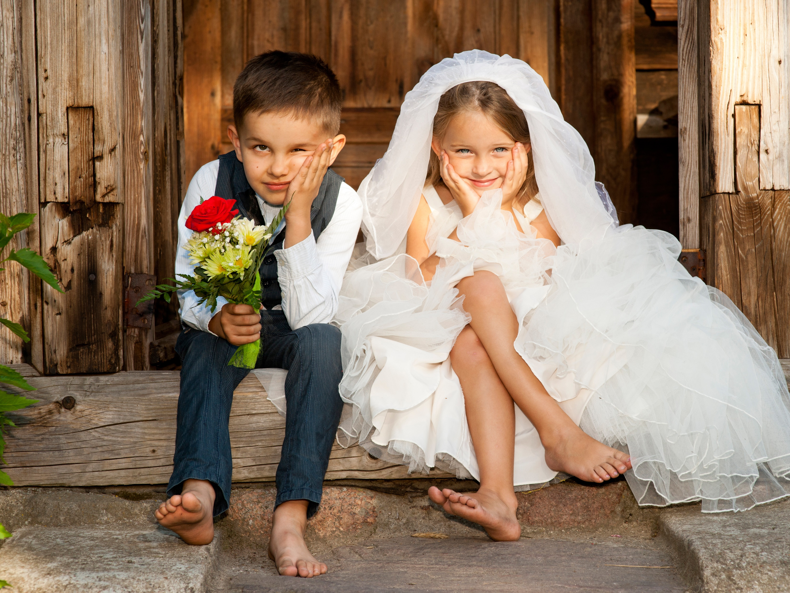
TO START
Soup of the Day with a Crusty Roll
or
Crudités with Hummus & Dough Balls with Garlic Butter
or
Cheesy Garlic Bread
Mains
Fish Fingers with Chips & Peas
or
Sausages with Chips & Beans
or
Chicken Nuggets (GF)
with Chips & Beans
Desserts
Chocolate Brownie (GF)
or
Ice Cream (3 Scoops)
Oreo
Salted Caramel
Vanilla Madagascar
Passion Fruit
Banana
Strawberry
CHILDREN’s WEDDING BREAKFAST
Designed for under 14’s
Priced at £15.00 per child
Jugs of Fruit Juice at £8.00 per Jug
( allows for 8 Glasses )

Slide 18
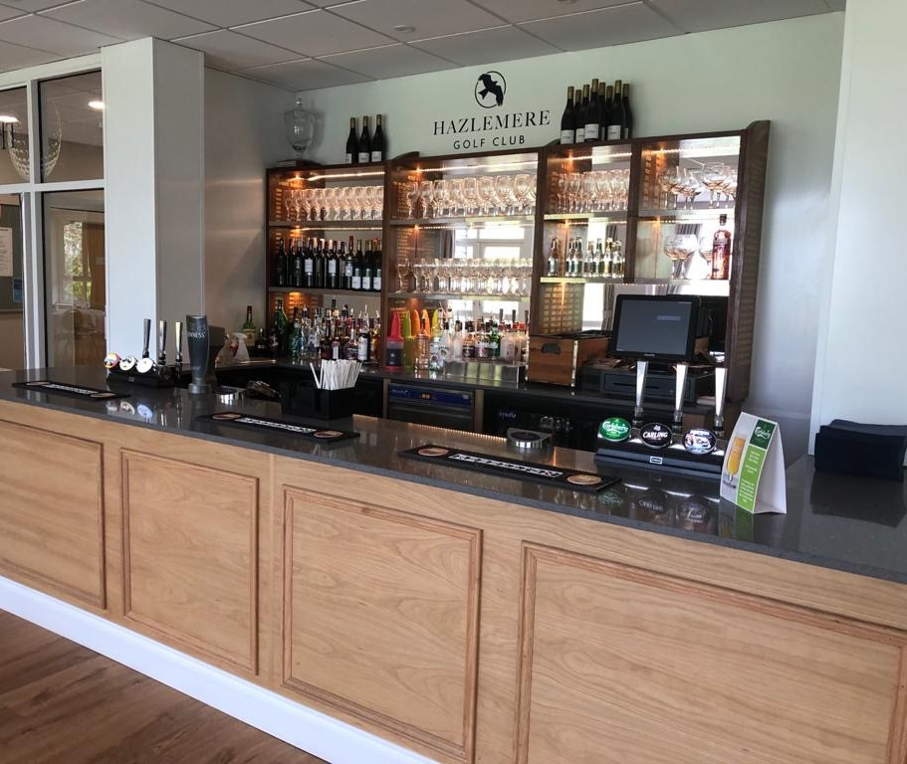
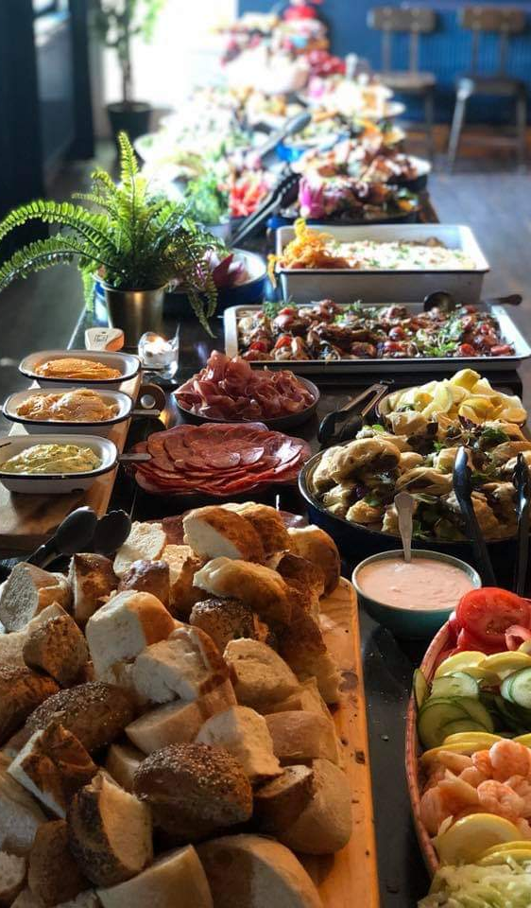
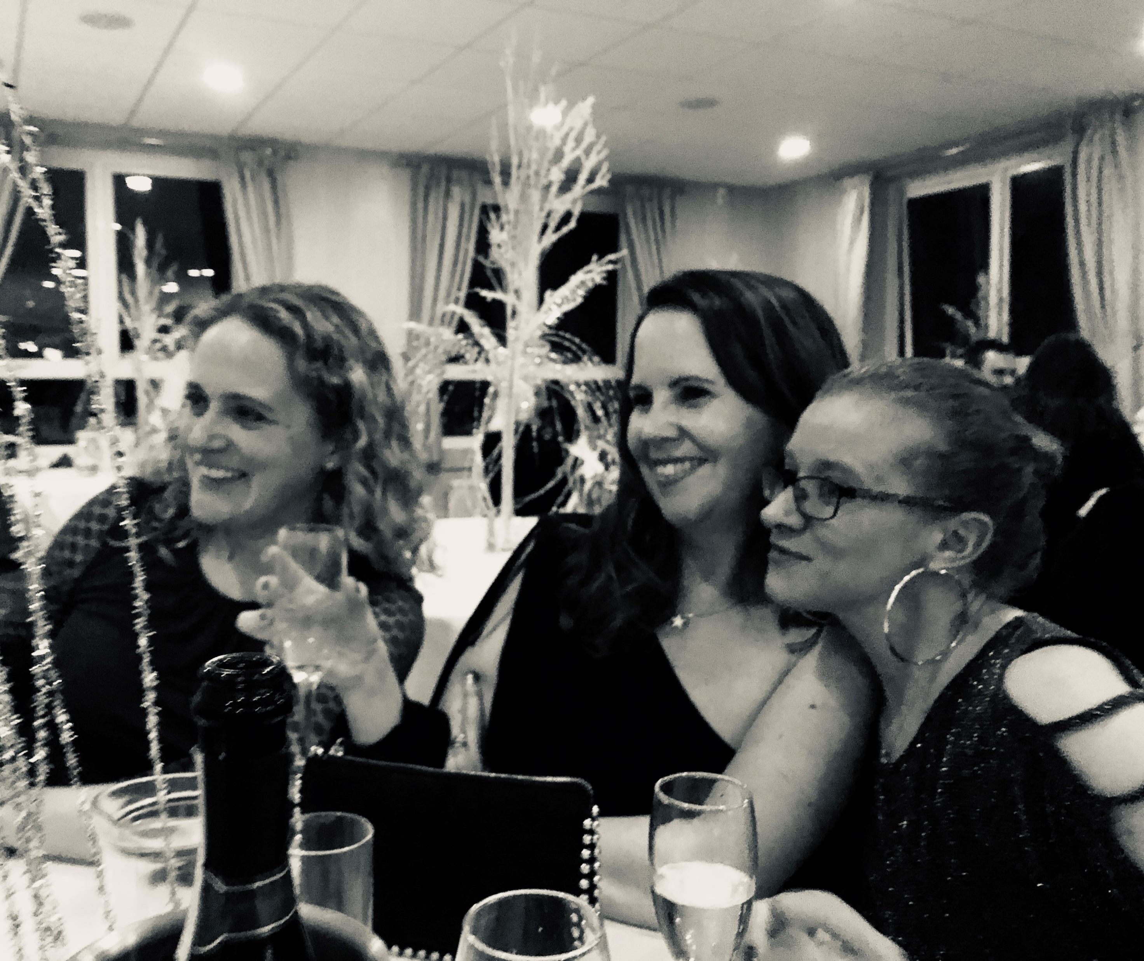
Evening Reception
It’s now time to Party!!
Following will be our Evening Finger Buffet for you to choose from:
Priced from:
The Hazlemere at £10.50pp
The Penn at £16.50pp
The Hughenden at £22.00pp

Slide 19

Party Buffet
The Hazlemere at £10.50
Selection of Sandwiches
on White & Brown Bread
White ((so)Brown (b)(so)
Egg Mayonnaise (e)(m)
Cheese & Pickle (d)
Ham & Mustard (m)
Tuna Mayonnaise (f)(m)(e)
Hummus & Red Pepper (Vegan)
Bowls of Tyrell Crisps
A slice of homemade Cake of the Day
Lemon Drizzle, Victoria Sandwich, Chocolate
(d)(g)(e)
Allergens
G(Gluten) D (Dairy) SOL (Sulphate)
E (eggs) B (barley) SO (soya) M (Mustard) F (Fish) Crus (Crustaceans)

Slide 20
Party Buffet
The Penn at £16.50
Selection of Sandwiches
on White & Brown Bread
White(so) Brown(b)(so)
Egg Mayonnaise (e)(m) Cheese & Pickle (d)
Ham & Mustard (m) Tuna Mayonnaise (f)(m)(e)
Hummus & Red Pepper (Vegan)
Bowls of our finest Chips
Sausage Rolls (w)(e)(milk)
Dessert Platter to include slices of homemade cakes, millionaire shortbreads, macaroons, profiteroles, fresh fruits
(d)(g)(e)
Allergens
G(Gluten) D (Dairy) SOL (Sulphate)
E (eggs) B (barley) SO (soya) M (Mustard) F (Fish) Crus (Crustaceans)

Slide 21
Party Buffet
The Hughenden at £22.00
Selection of Sandwiches
on White(so) & Brown Bread(b)(so)
Egg Mayonnaise (e)(m) Cheese & Pickle (d)
Ham & Mustard (m) Tuna Mayonnaise (f)(m)(e)
Hummus & Red Pepper (Vegan)
Hot Items
Chicken Bites(w) Sausage Rolls (w)(e)(milk)
Cod Goujons with tartar sauce (w)(e)(f) Vegetable Spring Rolls with a chilli dip (w)(b)(sesame)(so)(sul)
Garlic Breaded Mushrooms(v)(vegan) Mozzarella Sticks (v)(d)
Dessert Platter to include slices of homemade cakes, millionaire shortbreads, macaroons, profiteroles, fresh fruits (d)(g)(e)
Allergens
G(Gluten) D (Dairy) SOL (Sulphate)
E (eggs) B (barley) SO (soya) M (Mustard) F (Fish) Crus (Crustaceans)

Slide 22
TERMS & CONDITIONS
A Non-Refundable Deposit of £500 is required to secure your booking. The Final Balance for your big day is required 10 days prior to your Wedding Day | The Golf Course and Putting Green are strictly for the use of playing golfers and for Health and Safety reasons photographers must confirm safe areas for photos with a manager
All Beverages must be supplied by Hazlemere Golf Club | Children attending any function must be supervised by an adult at all times
Only freestanding decorations are permitted | No Children are allowed out on the balcony with an adult
Access to the Fairways Suite prior to the booking must be authorized by Hazlemere Golf Club | Hazlemere Golf Club cannot accept any liability for theft, loss, damage or injury.
Menus must be confirmed 28 days in advance and final numbers for catering must be given 14 days before the date of the function The hirer will be liable for any damage to the building, furnishing and golf course resulting from their or their guest actions | Cancellation Charges – please note these charges are over and above the deposit Six months notice £500 Three Months notice £750 One months notice £1000 14 Days Notice – Full Balance of the function

Slide 23
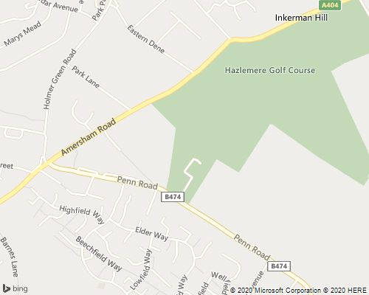

Our Beautiful Setting
Set in the Chilterns, an area of outstanding beauty!
How to find us
“We are close to Amersham, Gerrards Cross and Beaconsfield in South Bucks with easy access to the railway stations and the M40
There’s ample free parking for drivers who can arrive easily via the M40, M25, M1 and M4.
Hazlemere Golf Club
Penn Road
Hazlemere,
Buckinghamshire
HP15 7LR
www.hazlemeregolfclub.co.uk
All Wedding enquiries email Emily@hazlemeregolfclub.co.uk
Tel – 01494 719 300

